Slide 1



chapter 1
the human

Slide 2
Lucky you are!
Everyone who uses a tool—software or otherwise—has a reason for using it. For instance:
• Finding some fact or object
• Learning something
• Performing a transaction
• Controlling or monitoring something
• Creating something
• Conversing with other people
• Being entertained

Slide 3
the human
Information i/o …
  visual, auditory, haptic, movement
Information stored in memory
  sensory, short-term, long-term
Information processed and applied
  reasoning, problem solving, skill, error
Emotion influences human capabilities
Each person is different

Slide 4
Vision
Two stages in vision
• physical reception of stimulus
• processing and interpretation of stimulus

Slide 5
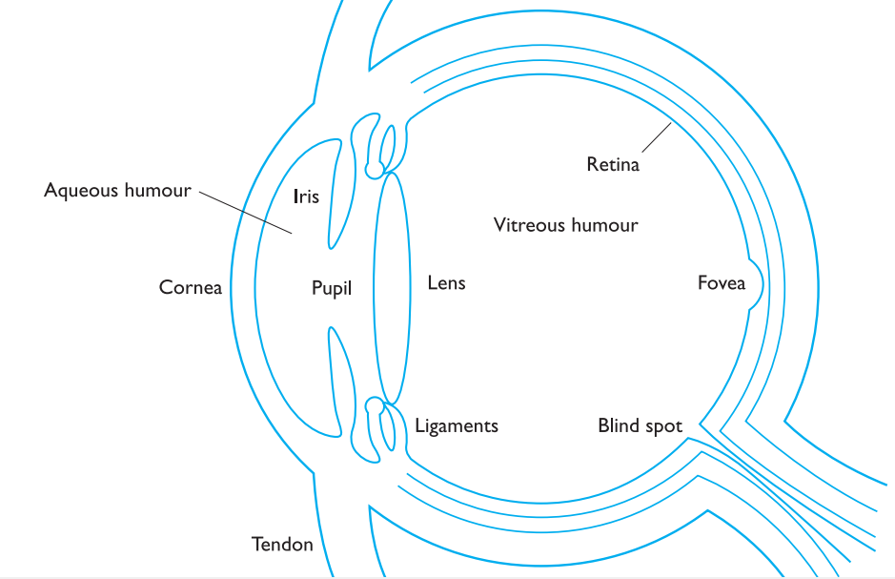
Human Eye

Slide 6
The Eye - physical reception
mechanism for receiving light and transforming it into electrical energy
light reflects from objects
images are focused upside-down on retina
retina contains rods for low light vision and cones for colour vision
ganglion cells (brain!) detect pattern and movement

Slide 7
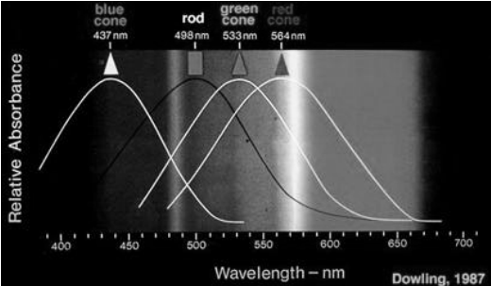
Rods and cones

Slide 8
Interpreting the signal
Size and depth
  visual angle indicates how much of view object occupies
  (relates to size and distance from eye)
  visual acuity is ability to perceive detail (limited)
  familiar objects perceived as constant size
  (in spite of changes in visual angle when far away)
  cues like overlapping help perception of size and depth

Slide 9
Imagine you are standing on a hilltop. Beside you on the summit you can see rocks, sheep and a small tree. On the hillside is a farmhouse with outbuildings and farm vehicles. Someone is on the track, walking toward the summit. Below in the valley is a small market town.

Slide 10
Interpreting the signal (cont)
Brightness
  subjective reaction to levels of light
  affected by luminance of object
  measured by just noticeable difference
  visual acuity increases with luminance as does flicker
Colour
  made up of hue, intensity, saturation
  cones sensitive to colour wavelengths
  blue acuity is lowest
  8% males and 1% females colour blind

Slide 11
Interpreting the signal (cont)
The visual system compensates for:
  movement
  changes in luminance.
Context is used to resolve ambiguity
Optical illusions sometimes occur due to over compensation

Slide 12
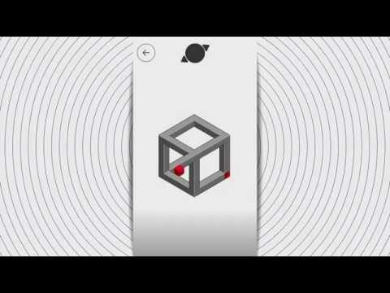
Optical Illusions
the Ponzo illusion
the Muller Lyer illusion

Slide 13
Reading
Several stages:
  visual pattern perceived
  decoded using internal representation of language
  interpreted using knowledge of syntax, semantics, pragmatics
Reading involves saccades and fixations
Perception occurs during fixations
Word shape is important to recognition
Negative contrast improves reading from computer screen

Slide 14
Hearing
Provides information about environment:
distances, directions, objects etc.
Physical apparatus:
  outer ear – protects inner and amplifies sound
  middle ear – transmits sound waves as
  vibrations to inner ear
  inner ear – chemical transmitters are released
  and cause impulses in auditory nerve
Sound
  pitch – sound frequency
  loudness – amplitude
  timbre – type or quality

Slide 15
Hearing (cont)
Humans can hear frequencies from 20Hz to 15kHz
  less accurate distinguishing high frequencies than low.
Auditory system filters sounds
  can attend to sounds over background noise.
  for example, the cocktail party phenomenon.

Slide 16
Touch
Provides important feedback about environment.
May be key sense for someone who is visually impaired.
Stimulus received via receptors in the skin:
  thermoreceptors – heat and cold
  nociceptors – pain
  mechanoreceptors – pressure
  (some instant, some continuous)
Some areas more sensitive than others e.g. fingers.
Kinethesis - awareness of body position
  affects comfort and performance.

Slide 17
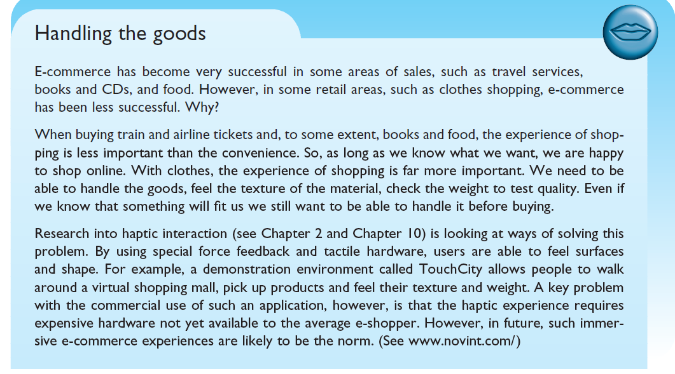

Slide 18
Movement
Time taken to respond to stimulus:
reaction time + movement time
Movement time dependent on age, fitness etc.
Reaction time - dependent on stimulus type:
  visual ~ 200ms
  auditory ~ 150 ms
  pain ~ 700ms
Increasing reaction time decreases accuracy in the unskilled operator but not in the skilled operator.

Slide 19
Movement (cont)
Fitts' Law describes the time taken to hit a screen target:
Mt = a + b log₂(D/S + 1)
  where: a and b are empirically determined constants
  Mt is movement time
  D is Distance
  S is Size of target
targets as large as possible
distances as small as possible

Slide 20
Memory
There are three types of memory function:
Sensory memories
Short-term memory or working memory
Long-term memory
Selection of stimuli governed by level of arousal.
Attention
Rehearsal

Slide 21
sensory memory
Buffers for stimuli received through senses
  iconic memory: visual stimuli
  echoic memory: aural stimuli
  haptic memory: tactile stimuli
Examples
  “sparkler” trail
  stereo sound
Continuously overwritten

Slide 22
Short-term memory (STM)
Scratch-pad for temporary recall
  rapid access ~ 70ms
  rapid decay ~ 200ms
  limited capacity - 7± 2 chunks

Slide 23
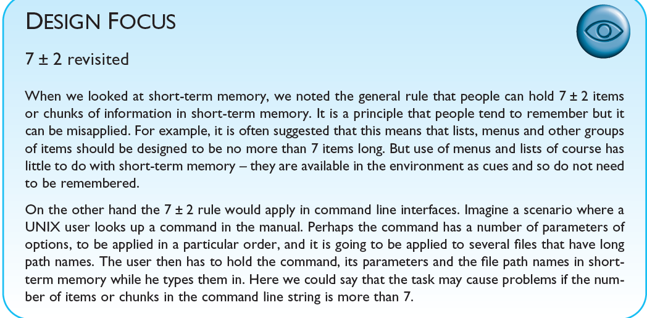


Slide 24
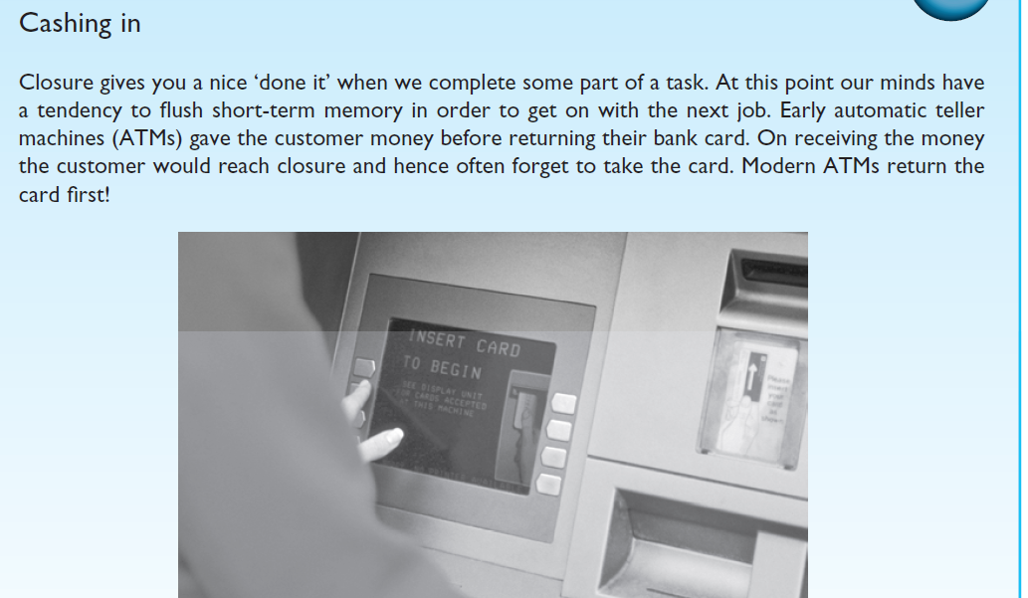

Slide 25
Examples
212348278493202
0121 414 2626
HEC ATR ANU PTH ETR EET

Slide 26
Long-term memory (LTM)
Repository for all our knowledge
  slow access ~ 1/10 second
  slow decay, if any
  huge or unlimited capacity
Two types
  episodic – serial memory of events
  semantic – structured memory of facts,concepts, skills
  semantic LTM derived from episodic LTM

Slide 27

Hopscotch

Slide 28

Seven Stones(Pittu garam)

Slide 29
Long-term memory (cont.)
Semantic memory structure
  provides access to information
  represents relationships between bits of information
  supports inference
Model: semantic network
  inheritance – child nodes inherit properties of parent nodes
  relationships between bits of information explicit
  supports inference through inheritance

Slide 30
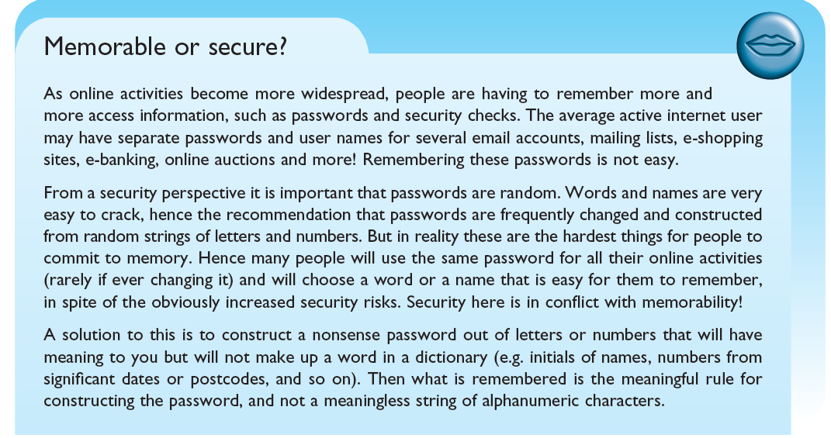

Slide 31

LTM - semantic network

Slide 32
Models of LTM - Frames
Information organized in data structures
Slots in structure instantiated with values for instance of data
Type–subtype relationships
DOG
Fixed
legs: 4
Default
diet: carniverous
sound: bark
Variable
size:
colour
COLLIE
Fixed
breed of: DOG
type: sheepdog
Default
size: 65 cm
Variable
colour

Slide 33
Models of LTM - Scripts
Model of stereotypical information required to interpret situation
Script has elements that can be instantiated with values for context
Consider the following sentence
John took his dog to the surgery. After seeing the vet, he left.

Slide 34
From our knowledge of the activities of dog owners and vets, we may fill in a
substantial amount of detail. The animal was ill. The vet examined and treated the animal. John paid for the treatment before leaving. We are less likely to assume the alternative reading of the sentence, that John took an instant dislike to the vet on sight and did not stay long enough to talk to him!

Slide 35
Script for a visit to the vet
Entry conditions: dog ill
vet open
owner has money
Result: dog better
owner poorer
vet richer
Props: examination table
medicine
instruments
Roles: vet examines
diagnoses
treats
owner brings dog in
pays
takes dog out
Scenes: arriving at reception
waiting in room
examination
paying
Tracks: dog needs medicine
dog needs operation

Slide 36
Entry conditions: Conditions that must be satisfied for the script to be activated.
Result: Conditions that will be true after the script is terminated.
Props: Objects involved in the events described in the script.
Roles: Actions performed by particular participants.
Scenes: The sequences of events that occur.
Tracks: A variation on the general pattern representing an alternative scenario.

Slide 37
Models of LTM - Production rules
Representation of procedural knowledge.
Condition/action rules
  if condition is matched
  then use rule to determine action.
IF dog is wagging tail
THEN pat dog
IF dog is growling
THEN run away

Slide 38
LTM - Storage of information
rehearsal
  information moves from STM to LTM
total time hypothesis
  amount retained proportional to rehearsal time
distribution of practice effect
  optimized by spreading learning over time
structure, meaning and familiarity
  information easier to remember
  List A: Faith Age Cold Tenet Quiet Logic Idea Value Past Large
  List B: Boat Tree Cat Child Rug Plate Church Gun Flame Head

Slide 39
LTM - Forgetting
decay
  information is lost gradually but very slowly
interference
  new information replaces old: retroactive interference
  (Remembering your new number)
  old may interfere with new: proactive inhibition
  (Driving to your old house while you shifted to new)
so may not forget at all memory is selective …
… affected by emotion – can subconsciously `choose' to forget

Slide 40
LTM - retrieval
recall
  information reproduced from memory can be assisted by cues, e.g. categories, imagery
  Recall the following list
  Child, red, plane dog friend blood cold tree big angry
recognition
  information gives knowledge that it has been seen before
  less complex than recall - information is cue

Slide 41
Thinking
Reasoning
deduction, induction, abduction
Problem solving

Slide 42
Deductive Reasoning
Deduction:
  derive logically necessary conclusion from given premises.
  e.g. If it is Friday then she will go to work
  It is Friday
  Therefore she will go to work.
Logical conclusion not necessarily true:
  e.g. If it is raining then the ground is dry
  It is raining
  Therefore the ground is dry

Slide 43
Deduction (cont.)
When truth and logical validity clash …
  e.g. Some people are babies
  Some babies cry
  Inference - Some people cry
Correct?
People bring world knowledge to bear

Slide 44
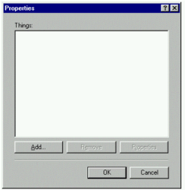

Slide 45
Inductive Reasoning
Induction:
  generalize from cases seen to cases unseen
  e.g. all elephants we have seen have trunks
  therefore all elephants have trunks.
Unreliable:
  can only prove false not true
… but useful!
Humans not good at using negative evidence
  e.g. Wason's cards.

Slide 46
Wason's cards
7 E 4 K
If a card has a vowel on one side it has an even number on the other
Is this true?
How many cards do you need to turn over to find out?
…. and which cards?

Slide 47
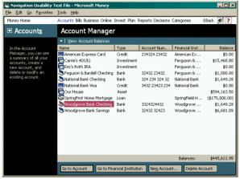
Money 99

Slide 48
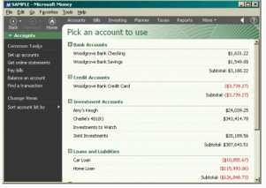
Money 2000

Slide 49


Slide 50
Abductive reasoning
reasoning from event to cause
  e.g. Sam drives fast when drunk.
  If I see Sam driving fast, assume drunk.
Unreliable:
  can lead to false explanations

Slide 51


Slide 52
Problem solving
Process of finding solution to unfamiliar task using knowledge.
Several theories.
Gestalt
  problem solving both productive and reproductive
  productive draws on insight and restructuring of problem
  attractive but not enough evidence to explain `insight' etc.
  move away from behaviourism and led towards information processing theories

Slide 53
Problem solving (cont.)
Problem space theory
  problem space comprises problem states
  problem solving involves generating states using legal operators
  heuristics may be employed to select operators
  e.g. means-ends analysis
  operates within human information processing system
  e.g. STM limits etc.
  largely applied to problem solving in well-defined areas
  e.g. puzzles rather than knowledge intensive areas

Slide 54
Problem solving (cont.)
Analogy
  analogical mapping:
    novel problems in new domain?
    use knowledge of similar problem from similar domain
  analogical mapping difficult if domains are semantically different
Skill acquisition
  skilled activity characterized by chunking
    lot of information is chunked to optimize STM
  conceptual rather than superficial grouping of problems
  information is structured more effectively

Slide 55
A doctor is treating a malignant tumor. In order to destroy it he needs to blast it with high-intensity rays. However, these will also destroy the healthy tissue surrounding the tumor. If he lessens the rays’ intensity the tumor will remain. How does he destroy the tumor?

Slide 56
Errors and mental models
Types of error
slips
  right intention, but failed to do it right
  causes: poor physical skill,inattention etc.
  change to aspect of skilled behaviour can cause slip
mistakes
  wrong intention
  cause: incorrect understanding
    humans create mental models to explain behaviour.
    if wrong (different from actual system) errors can occur

Slide 57
Emotion
Various theories of how emotion works
  James-Lange: emotion is our interpretation of a physiological response to a stimuli
  Cannon: emotion is a psychological response to a stimuli
  Schacter-Singer: emotion is the result of our evaluation of our physiological responses, in the light of the whole situation we are in
Emotion clearly involves both cognitive and physical responses to stimuli

Slide 58
Emotion (cont.)
The biological response to physical stimuli is called affect
Affect influences how we respond to situations
  positive → creative problem solving
  negative → narrow thinking
  “Negative affect can make it harder to do even easy tasks; positive affect can make it easier to do difficult tasks”
        (Donald Norman)

Slide 59
Emotion (cont.)
Implications for interface design
  stress will increase the difficulty of problem solving
  relaxed users will be more forgiving of shortcomings in design
  aesthetically pleasing and rewarding interfaces will increase positive affect

Slide 60
Individual differences
long term
– gender, physical and intellectual abilities
short term
– effect of stress or fatigue
changing
– age
Ask yourself:
will design decision exclude section of user population?

Slide 61
Psychology and the Design of Interactive System
Some direct applications
  e.g. blue acuity is poor
  ⇒ blue should not be used for important detail
However, correct application generally requires understanding of context in psychology, and an understanding of particular experimental conditions
A lot of knowledge has been distilled in
  guidelines (chap 7)
  cognitive models (chap 12)
  experimental and analytic evaluation techniques (chap 9)

